Slide 1



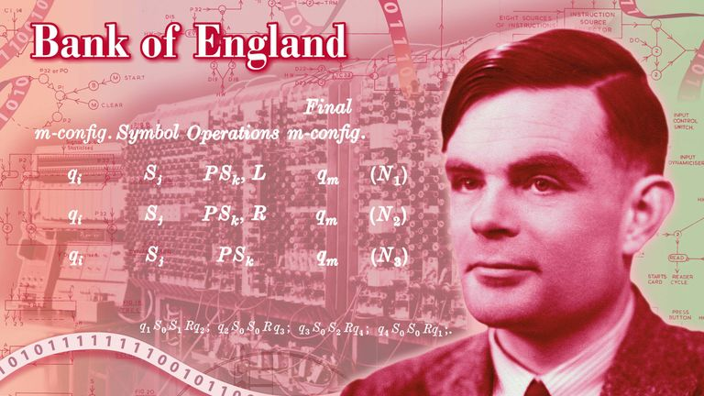

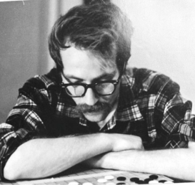

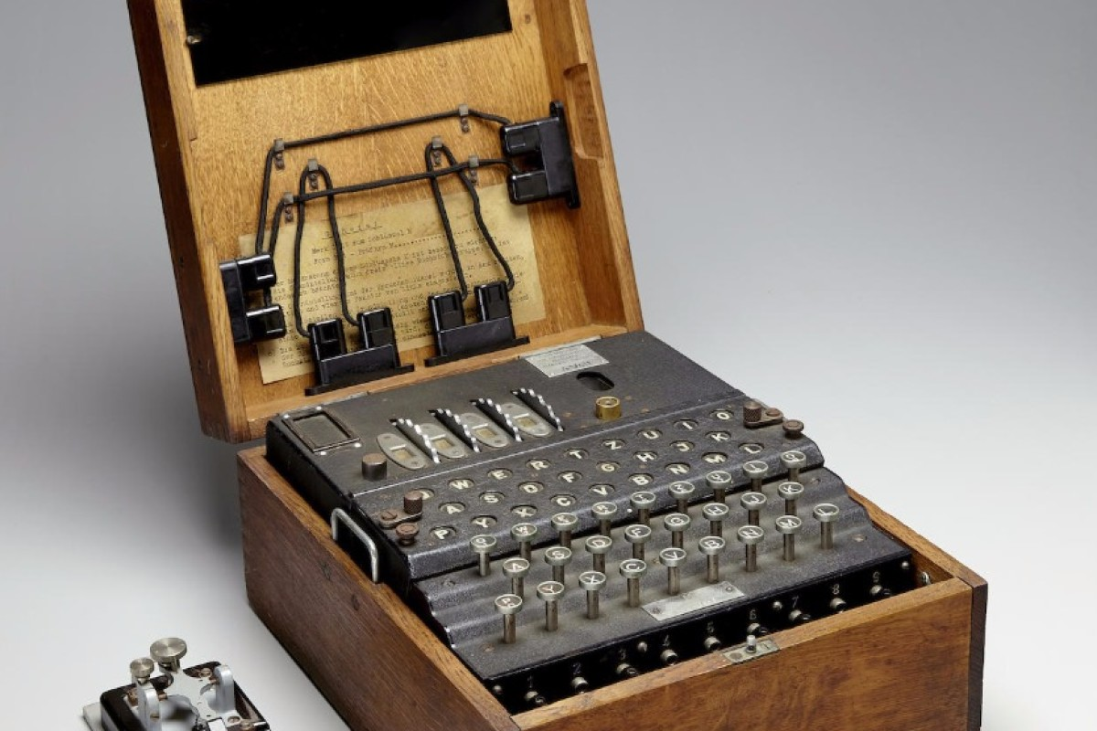

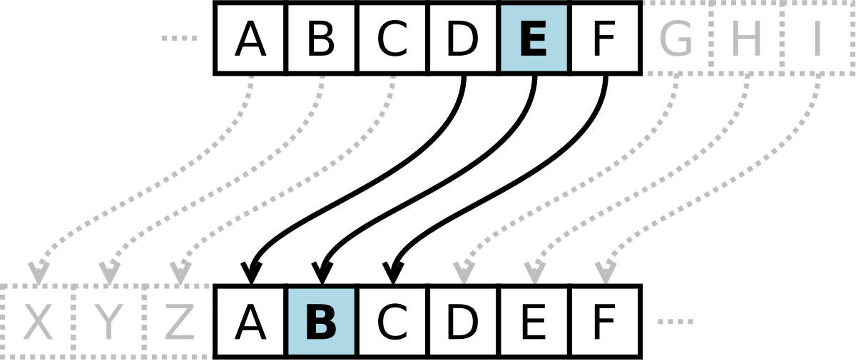
A Study of Cryptography In History with a Focus on Computer Science Tom Carey, Benjamin Setterfield, Ian Rowland, Ruadhrí Ryan University of Limerick Computer Science Department
Ancient Cryptographic Efforts
History of Cryptography in Computer Science
Alan Turing
The importance of cryptography in Modern computer science
Early Cryptographic efforts amounted to simple writing or the replacement or obfuscation of symbols used in writing. As time progressed these would become more complex, while still a far cry from the modern cryptographic efforts we know today, these early attempts to hide information from all but those who were required to read it were effective and sowed the seeds for future cryptographic techniques to be developed. Even the famed German Engima cipher would not exist without the techniques of the Egyptians, Greek and Romans.
The 1950’s saw the introduction of an encryption machine called TSEC/KL-7 for use by the National Security Agency. It is probably better known by it’s codename, Adonis. It would become the most widely used encryption machine in the US armed forces.
The life and work of Alan Mathison Turing. Famous for his work to crack the Enigma code of World War Two and his contribution to a mass of scientific fields of study such as mathematics, cryptanalysis, philosophy, logic, biology, computer science, cognitive science, artificial intelligence and artificial life.
Recognised for his great intellect and skill in these subjects but also known for the cruel prosecution placed on him after his incredible service to the Allies during the war and the world at large.
Cryptography plays a massively important role in modern Computer Science, as it allows for many of the most important uses of computers and wireless systems in the modern age. Without it, many important aspects of modern life that we take for granted would not be possible, such as the use of private messaging apps, like WhatsApp, or ensuring that e-mails, and data that is stored on the cloud, can only be accessed by their intended users. Without the encryption that modern cryptography provides, none of these things would be possible, and the internet would not likely be the useful tool that it is today.
The Enigma Machine
An icon of World War Two that protected military messages with an extreme and complex system that produced 158,962,555,217,826,360,000 permutations. Considered by many at the time to be unbreakable, the Enigma Machine would come to define Alan Turing and his work as a cryptographer attempting to crack the naval code's of the German military. The Enigma Machine had one flaw that meant it was not as unbreakable as many had believed, a flaw that Alan Turing was able to take full advantage of.
At the beginning of the 1970’s, research physicist Stephen Wiesner invented conjugate coding in an attempt to make money impossible to counterfeit and, although this was not achieved, the coding itself is still used in quantum computing.
Overview of the modern applications of cryptography
Cryptographical Advancements
Some of the most important applications of cryptography in modern computer science include the secure storing of encrypted passwords, secure communications, especially regarding End-to-End encryption, and in ensuring the security of data that is stored on the cloud. These are immensely important uses for cryptography, as they allow for the safe use of computers, allowing information to be transmitted and stored online, whilst also maintaining the privacy of such information.
The most famous advancement on ancient cryptographical techniques is the Caesar Cipher. It is a basic substitution cipher that shifts the letters in the message by a pre chosen amount. Shifting one letter would make A = B, C=D, Z=A etc. This was an easily broken Cipher once you realized what it was but it set the stage for many more complex ciphers to be created using it as a template to build from, such as the Simple Substitution Cipher which replaces letters according to a key. For example A may be G while B may be A.
"A Brief History of Cryptography", Inquiries Journal, Vol. 1(11) - Damico, T. (2009)
“Origin of Cryptography” - Tutorialspoint (2020)
“Security of Password Hashing in Cloud” - Kamal, P. (2019)
“End-to-End Encryption in Messaging Services and National Security—Case of WhatsApp Messenger.” - Endelay, R.E (2018)
“The Study of the Application of Data Encryption Techniques in Cloud Storage to Ensure Stored Data Integrity and Availability” - Stephen, O. (2014)

